Slide 1
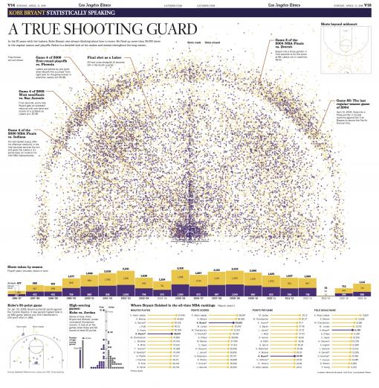
Kobe Bryant:
“A True Shooting Guard” … Or Was He?
Brunda Chouthoy, Kiron Mishra,
John Misailedes, Craig Stanek, Samantha Stanley
June 2, 2016
Infographic Source: Los Angeles Times
Notes:
After 20 seasons in the NBA—all with the Los Angeles Lakers—Kobe Bryant played his final game on April 13th of this year (and scored 60 points!)
To commemorate the occasion, the LA Times put together this visualization of every shot taken in his career (purple are shots made and gold shots missed … clever use of the Lakers’ colors)
Kobe is widely regarded as one of the NBA’s all-time greatest shooting guards, an 18-time All-Star, 15-time All-NBA team player (including league MVP in 2008), and a 12-time All-Defensive team selection; his teams won 5 NBA titles, and he ranks 3rd on the league’s all-time scoring list
Using detailed shot data made available on Kaggle, we found some evidence to challenge this notion
Note that the objective of the Kaggle competition was to try to predict whether Kobe made or missed on 5,000 shots (out of 30,000+ total shots during his career) that had the actual result removed; therefore, our focus naturally gravitated towards field goal percentage as a predictor for made/missed … just be aware that the results we display will not align perfectly with his career stats, but we feel that it is a representative sample

Slide 2
1999-00
2000-01
2001-02
2008-09
2009-10
Notes:
To provide a baseline for the analysis, we started with this dual-axis look at Kobe’s overall field goal percentage, which was only 44.6% for his career (as shown by the darker dotted line) … the blue line displays how this percentage varied from year-to-year
For comparison purposes, Michael Jordan’s career field goal percentage (49.7%) is displayed as the lighter dotted line … note that Kobe did not come close to achieving that level in a single season of his career; for further perspective, Steph Curry’s field goal percentage for this past season was 50.4%, and more than half of his shots were 3-pointers!
What we found was that Kobe’s field goal percentage was largely a function of the type of shots he took (as indicated by the stacked vertical bar portion of the graph) and since jump shots easily comprised the largest percentage of shots each season, how his jump shot field goal percentage evolved over time (as indicated by the gold line)
So early in his career, Kobe’s overall FG% got better as he improved his jump shot and used his athleticism to get a lot of dunks and layups (the brown and green portions of the stacked bars) … won 3 straight titles in 1999-00 thru 2001-02 (as indicated by those years appearing in bold and underlined, as are 2008-09 and 2009-10 as well)
Then he went through a period where his jump shot shooting declined—bottoming out in 2003-04—and his overall shooting percentage suffered accordingly
What appeared to be a renewed effort on his jump shot brought his overall field goal percentage to peak levels in 2007-08 and 2008-09 … which coincided with return to NBA finals in both those seasons as well as 2009-10 (won the latter two of those)
But beginning after 2007-08, he became more and more reliant upon jump shots (note the decreasing presence of brown and green bars), and his overall FG% began to drop again; there was what appeared one last renewed effort in 2012-13 to get to the basket more often but then he got injured in 2013-14 and was almost exclusively dependent on a failing jump shot for his final two seasons

Slide 3
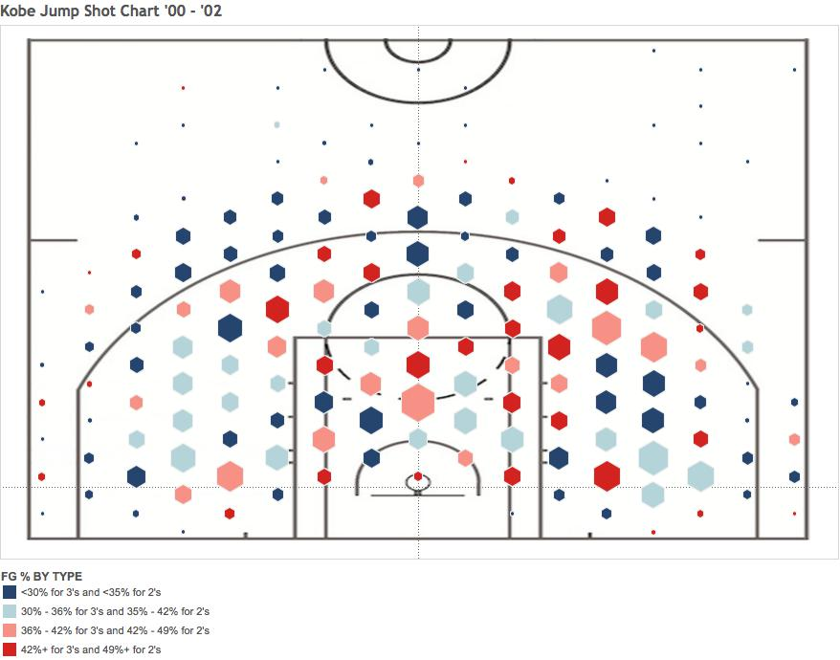
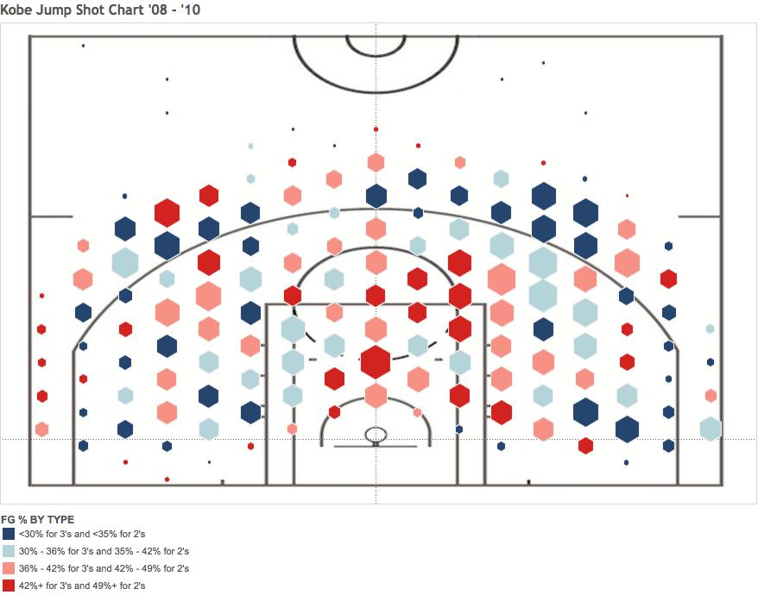

Slide 4
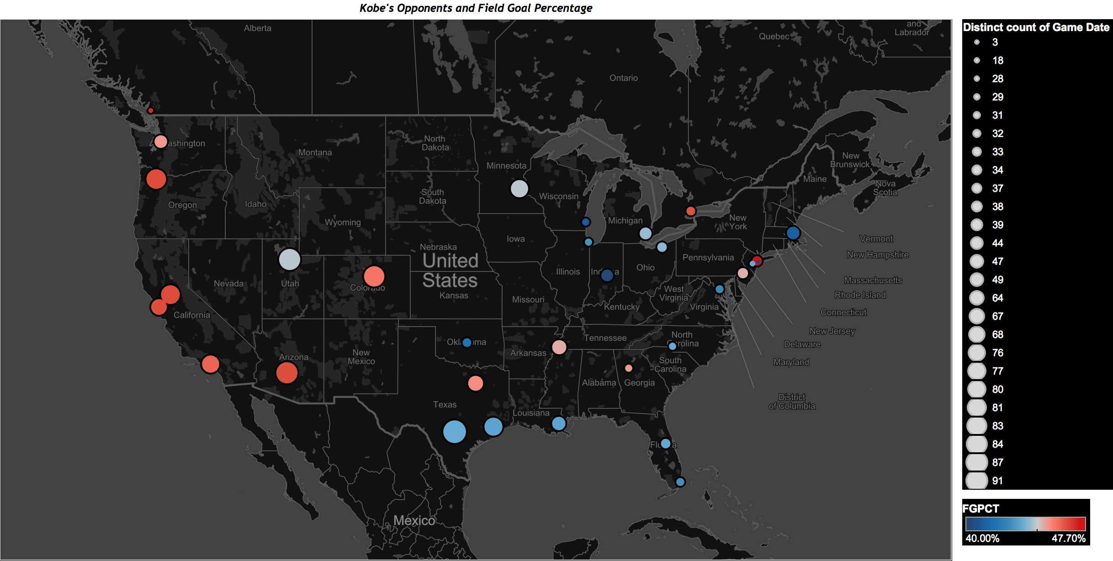
Notes:
Notice any distinct geographical patterns?
Yes, most of the red circles reside in the Western portion of the U.S., meaning Kobe tended to have his better performances (at least from a field goal percentage basis) against Western Conference teams
This is significant because teams play a much larger percentage of their games against teams from their own conference
It’s also representative of the general style of play associated with each conference: Western teams are known to play more of an open-court and up-tempo style while Eastern squads rely on a more rugged, physical, defensive-minded approach
Had Kobe played for an Eastern conference team rather than the Lakers (he was actually drafted by Charlotte and then traded later that day to LA), his numbers could have been far worse

Slide 5
44.6%
Notes:
Kobe’s greatest shot volumes were in the 1st and 3rd periods
His shots taken were lower in the 2nd and 4th quarters, especially in the first few minutes … this suggests a general pattern whereby he would rest in the early parts of those quarters
Then his shot totals start increasing, suggesting his standard playing pattern was that he came back into the game a little before the middle of the period, and his shooting percentage was much higher in those first few minutes after getting some rest
Plus, you can see that the first quarter is almost all red (fresh to start the game), and the same can be said for the early part of the 3rd quarter (perhaps needing a minute to get back into the flow after the halftime break)
There is a whole lot of blue in the 4th quarter … definite evidence to suggest he was not a great clutch performer, either suffering from fatigue or perhaps trying to do too much on his own, or a combination of both
His shooting percentage for the last minute of each period was extremely poor, but that may just be a function of desperation shots to try to beat the buzzer in the last few seconds … but it deserves a closer look, particularly for the end of games (lead-in to following slide or interactive demo)

Slide 6
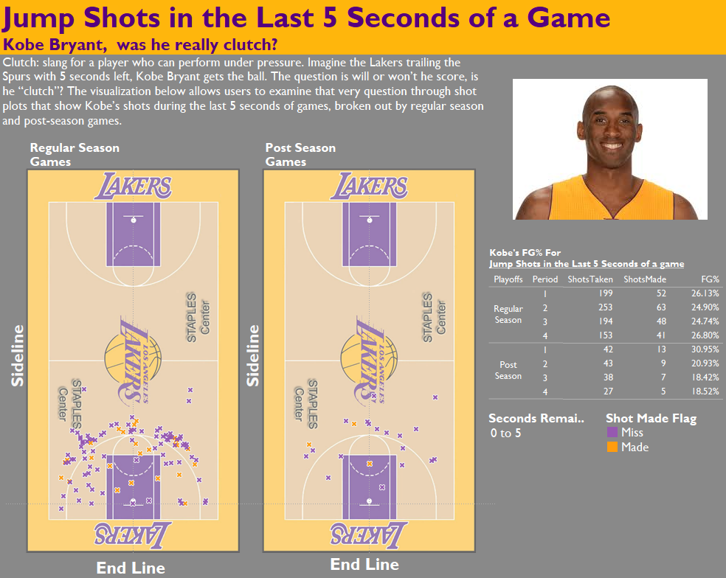

Slide 7
